Slide 1

Merge Sort
Rajesh Kumar Tripathi
Assistant Professor
Dept. of CEA, GLA University, Mathura

Slide 2
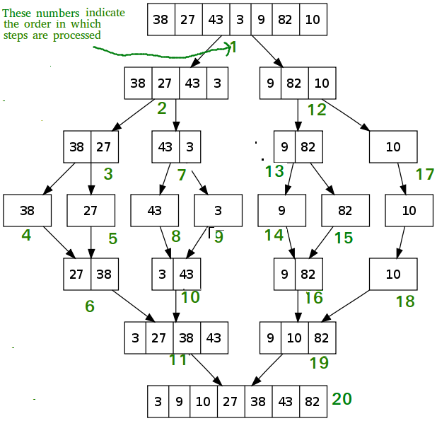
Merge Sort

Slide 3
contd..
void mergeSort(int arr[], int l, int r)
{
if (l < r) {
int m = l+(r-l)/2;
mergeSort(arr, l, m);
mergeSort(arr, m+1, r);
merge(arr, l, m, r); }
}

Slide 4
contd..
// Merges two subarrays of arr[].
// First subarray is arr[l..m]
// Second subarray is arr[m+1..r]
void merge(int arr[], int l, int m, int r)
{
int i, j, k;
int n1 = m - l + 1;
int n2 = r - m;
int L[n1], R[n2];
for (i = 0; i < n1; i++)
L[i] = arr[l + i];
for (j = 0; j < n2; j++)
R[j] = arr[m + 1+ j];

Slide 5
contd..
i = 0; // Initial index of first subarray
j = 0; // Initial index of second subarray
k = l; // Initial index of merged subarray
while (i < n1 && j < n2)
{
if (L[i] <= R[j]) {
arr[k] = L[i];
i++; }
else{
arr[k] = R[j];
j++; }
k++;
}

Slide 6
contd..
while (i < n1)
{
arr[k] = L[i];
i++;
k++;
}
while (j < n2)
{
arr[k] = R[j];
j++;
k++;
}
}

Slide 7
contd..
Compute complexity ?

Slide 8
Thank You Keep Learning…

